Slide 1
THE FUSION OF CHATBOTS AND AUGMENTED REALITY
Unmatched E-Commerce Experiences
SITARA KHURRAM

Slide 2
INTRODUCTION
Shift to online Shopping
Online Shopping Transformation:
It is Convenient but with challenges.
Problems include the inability to try products.
It affects the overall experience of online shopping.
Creative Tech Solution:
These shortcomings of online shopping can be addressed with Integration of Chatbots and Augmented Reality.
Aims to address and overcome common online shopping challenges.
Purpose is to use technology for a better, more enjoyable experience.
Fusion Benefits:
Real-time try-ons through AR.
Chatbots providing assistance and personalized recommendations.
Transforming the virtual shopping journey for users.

Slide 3
ONLINE SHOPPING CHALANEGES
Lack of Physical Try-Ons
Limited Price Comparison
Without the ability to try on clothes or products, users can feel uncertain about how things will actually look or fit.
Challenges in conducting real-time price comparisons across various platforms.
Customers may miss out on potential cost savings or better deals.

Slide 4
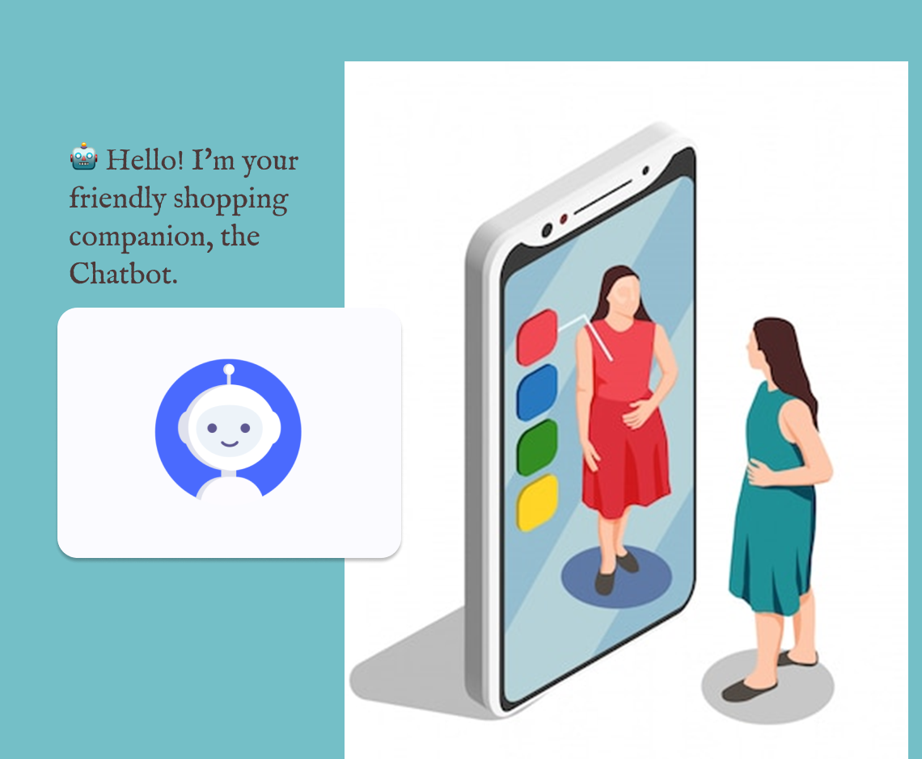
OBJECTIVES
Real-Time Apparel Try-ons:
A system where you can virtually try on clothes in real-time. No more guessing how they'll look – you can see it instantly
Chatbot Assistance:
A user friendly chatbot helps out during the shopping journey. It can answer your questions, suggest sizes, and even give the latest info about products.
Price Comparison:
This research focuses on integrating a feature that allows you to compare prices across different online stores in real-time, ensuring you make informed and budget-friendly choices.

Slide 5

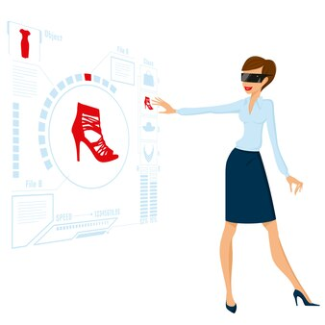

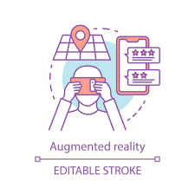

EXISTING SOLUTIONS
VIRTUAL TRY-ON SYSTEMS
MARKER-LESS AUGMENTED REALITY FOR E-COMMERCE
SMART DRESSING MIRRORS

Slide 6
EXISTING SOLUTIONS - SHORTCOMINGS
1.Limited Focus on Real-Time Price Comparisons:
Many current solutions lack a dedicated focus on providing dynamic and real-time price comparisons across various e-commerce platforms, a critical feature for informed decision-making.
2.Inadequate Size Recommendations:
The existing systems may not sufficiently address the need for personalized size recommendations, leaving users with uncertainties about whether a selected size will fit them accurately.
3.Minimal Chatbot Assistance:
Some solutions lack the robust chatbot integration needed for comprehensive user support. A well-designed chatbot can provide instant answers, offer detailed product information, and enhance the overall shopping experience.

Slide 7



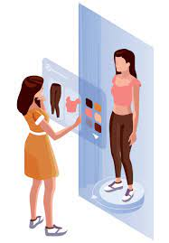
Chatbot Integration
PROPOSED SOLUTION
Augmented Reality for Real-Time Try-Ons
The proposed solution brings together Chatbots and Augmented Reality (AR) with real time price comparison for an immersive online shopping experience
Real Time Price Comparision

Slide 8
PROCESS FLOW
Enhanced Shopping Experience:
User Interacation
Post-Purchase Support:
Opt for "Virtual Try-on
Engage in dynamic conversations with the chatbot.
Select an outfit to trigger real-time price comparison.
Approach the smart mirror; motion sensors initiate engagement.
Navigate the interface effortlessly through touch gestures or voice commands.
Personalized post-purchase assistance.
Initiate a secure checkout process, review selections, and place orders.
Access delivery information and track order status.

Slide 9

- CHATBOT INTEGRATION
MOTION SENSOR ACTIVATE CHATBOT
As you approach, motion sensors detect your presence, triggering the chatbot's activation. It's ready to assist you
ADDRESSES USER QUERIES ABOUT PRODUCT DETAILS
🤖 Hello! I'm your friendly shopping companion, the Chatbot.
RECOMMEND USER ABOUT PRICES AND SIMILAR ITEMS
Post-Purchase Assistance

Slide 10
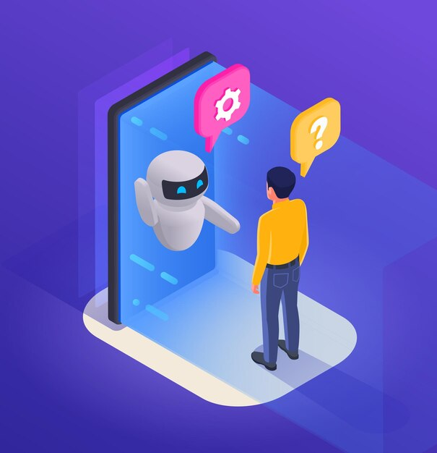
Technical Details - Chatbot Integration
Activation Mechanism:
Utilizes motion sensors for intelligent activation upon user presence.
Natural Language Processing (NLP):
Implements NLP algorithms, including deep learning models, for semantic understanding of user queries.
Virtual Try-On Algorithms:
Computer vision techniques, such as convolutional neural
Rendering algorithms for realistic virtual try-ons (CNNs),

Slide 11
Technical Details - Chatbot Integration
Machine Learning Models:
Utilizes ML models for continuous refinement
Real-Time Price Comparison Algorithms
Web scraping techniques coupled with machine learning algorithms
to dynamically extract, normalize, and compare prices
Interaction Methods
Capacitive touch sensors for gesture recognition
Voice recognition algorithms for natural language voice commands
Adaptive Algorithms:
Unsupervised learning techniques to adapt and learn from user interactions

Slide 12
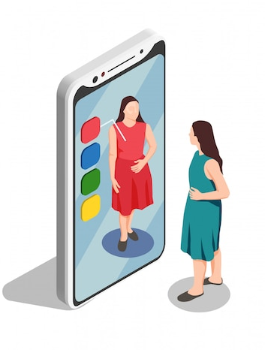
Technical Details - Augmented Reality
The virtual try-on employs computer vision techniques, particularly Convolutional Neural Networks (CNNs). These CNNs are advanced neural network architectures specialized in processing visual information. They analyze and understand the unique features of your appearance. Rendering algorithms, then, use this information to simulate how different clothing items would realistically look on you, creating a detailed and accurate virtual representation for an enhanced online shopping experience.

Slide 13

TECHNICAL DETAILS - REAL-TIME PRICE COMPARISON
01
E-COMMERCE PLATFORMS INTEGRATION MODULE: ESTABLISHES VITAL API CONNECTIONS
02
PRODUCT IDENTIFICATION AND PRICE DATA RETRIEVAL: USES WEB SCRAPING AND MACHINE LEARNING.
03
DATA NORMALIZATION: MAINTAINS CONSISTENCY AND COHERENCE.
04
COMPARISON ALGORITHM & SELECTION:APPLIES STATISTICAL MODELS AND MACHINE LEARNING.
05
DISPLAY RESULTS TO USER: PRESENTS OUTCOMES ON THE SMART MIRROR INTERFACE.

Slide 14
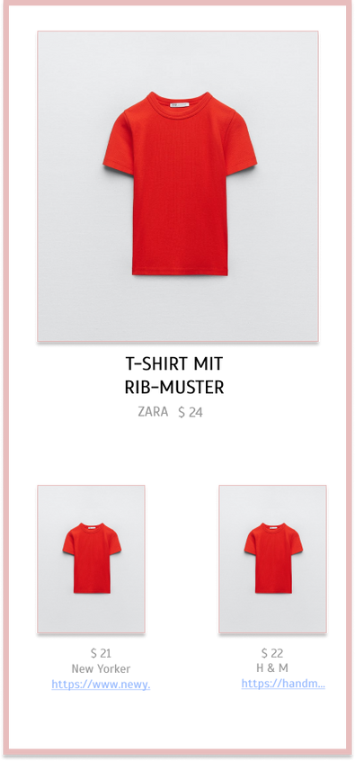
REAL-TIME PRICE COMPARISON - MODULE
Display Results to User:
Utilizes a user-friendly interface on the smart mirror to present price comparison outcomes, showcasing matched products, their corresponding prices, and links to original listings on respective e-commerce sites.

Slide 15
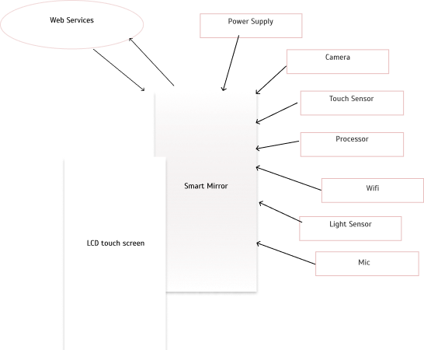
HARDWARE SPECIFICATIONS

Slide 16
CONCLUSION
The integration of Chatbots and AR within the smart mirror doesn't just redefine online shopping; it establishes a technical paradigm where technology serves as an enabler of seamless, empowered, and continuous virtual shopping expierence.

Slide 17


Thank you
I really appreciate your time.

